Slide 1
RAM PROGRAM : DEFINITION AND IMPLEMENTATION

Slide 2
Why RAM program ?
Random Access Machine
My implementation as general-purpose CPU

Slide 3
Why RAM program ?
Zero-Knowledge Proof :
Prover convinces the Verifier that he/she knows a witness w on which a particular program P evaluates to 1
Program P is usually expressed as a boolean or arithmetic circuit.
Unintended to run the program P on RAM model. Can cause suboptimal performance.

Slide 4
2. Random access machine
A “next-instruction circuit” ∏ that given the current state and a value d, outputs the next instruction to execute. (d is the value of last-read element)
M = [M₀ , M₁, …, M_{N - 1}] (N be the length of the memory)
M_{i} ∈ {0, 1}^{W}
st := start, d := 0

Slide 5
2. Random access machine
Do until termination :
Compute (op, l, d’, st’) := ∏(st, d) and set st := st’
If op = stop, terminate with d’
If op = read, set d := M_{l}
If op = write, set M_{l} := d’ and d := d’

Slide 6
2. Random access machine
The RAM program may be represented as :
Algorithm running on RAM model
A general-purpose CPU (executing assembly code). Then the state st should consist of a program counter pc and an array of registers R.

Slide 7
RAM Program as algorithm
Binary search for element target in an increasing memory M with l entries

Slide 8
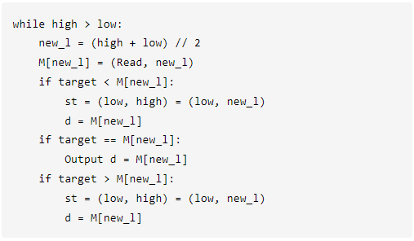

Slide 9
2. Random access machine
Time complexity : ∑(I_{i} x cycles_{i}) ∈ P need to execute.
Space complexity : total entries of memory space M

Slide 10
3. My implementation as general-purpose CPU
Use the program P as assembly code adapted from MIPS Instruction Set.
Using Python to temporarily implement

Slide 11
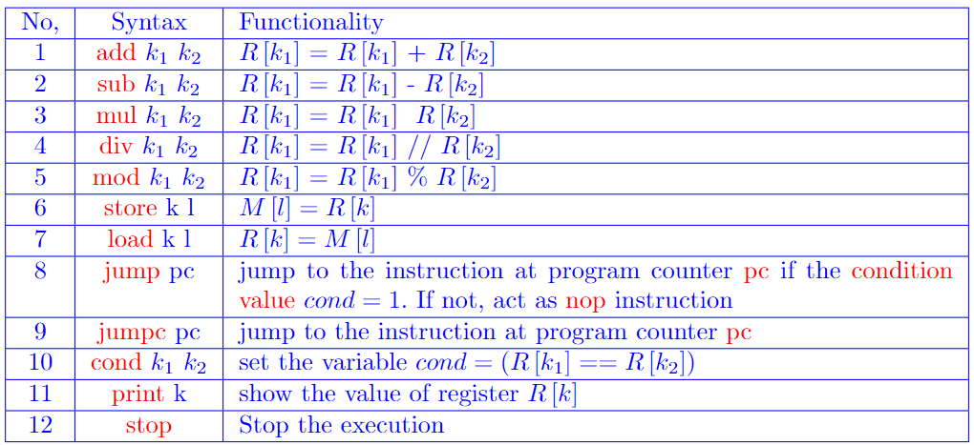
Some instructions

Slide 12
DEMO

Slide 13
Improvements
Vary the parameters and inputs rather than just inputs
Implement using Rust instead of Python to cope with ZKP
More instructions of mathematical and boolean operators
Debug and Exception handling mechanisms
Detailed performance evaluation
A more strict access to certain registers and memory

Slide 14
THANK YOU

